Slide 1
Raum G013 Lageplan „IOT-Sensoren“
WS 2021/22
Business Intelligence

Slide 2
Ca. 9m
N
Sensor #2
bh1750_illuminance_2
Fenster H= 0,5m B=1,3m
Fenster H= 0,5m B=1,3m
Fenster H= 0,5m B=1,0m
2
Fenster H= 0,5m B=1,0m
Fenster H= 0,5m B=1,45m
Fenster H= 0,5m B=1,45m
Heizkörper
Heizkörper
Smartplug3
sensor.smartplug3_*
Smart-plug3
Pi
Sensor #1
bh1750_illuminance bme280_*
1
Smart-plug1
Sensor #3
ccs811_* dht22_*
mh_z19_co2_*
3
Ca. 5m
Fischer-technik
Smartplug1
sensor.wlan_switch_*
G013
Deckenhöhe 3,0m
10 Deckenlampen Maße 0,5m*0,5m
Klimaanlage vorhanden

Slide 3
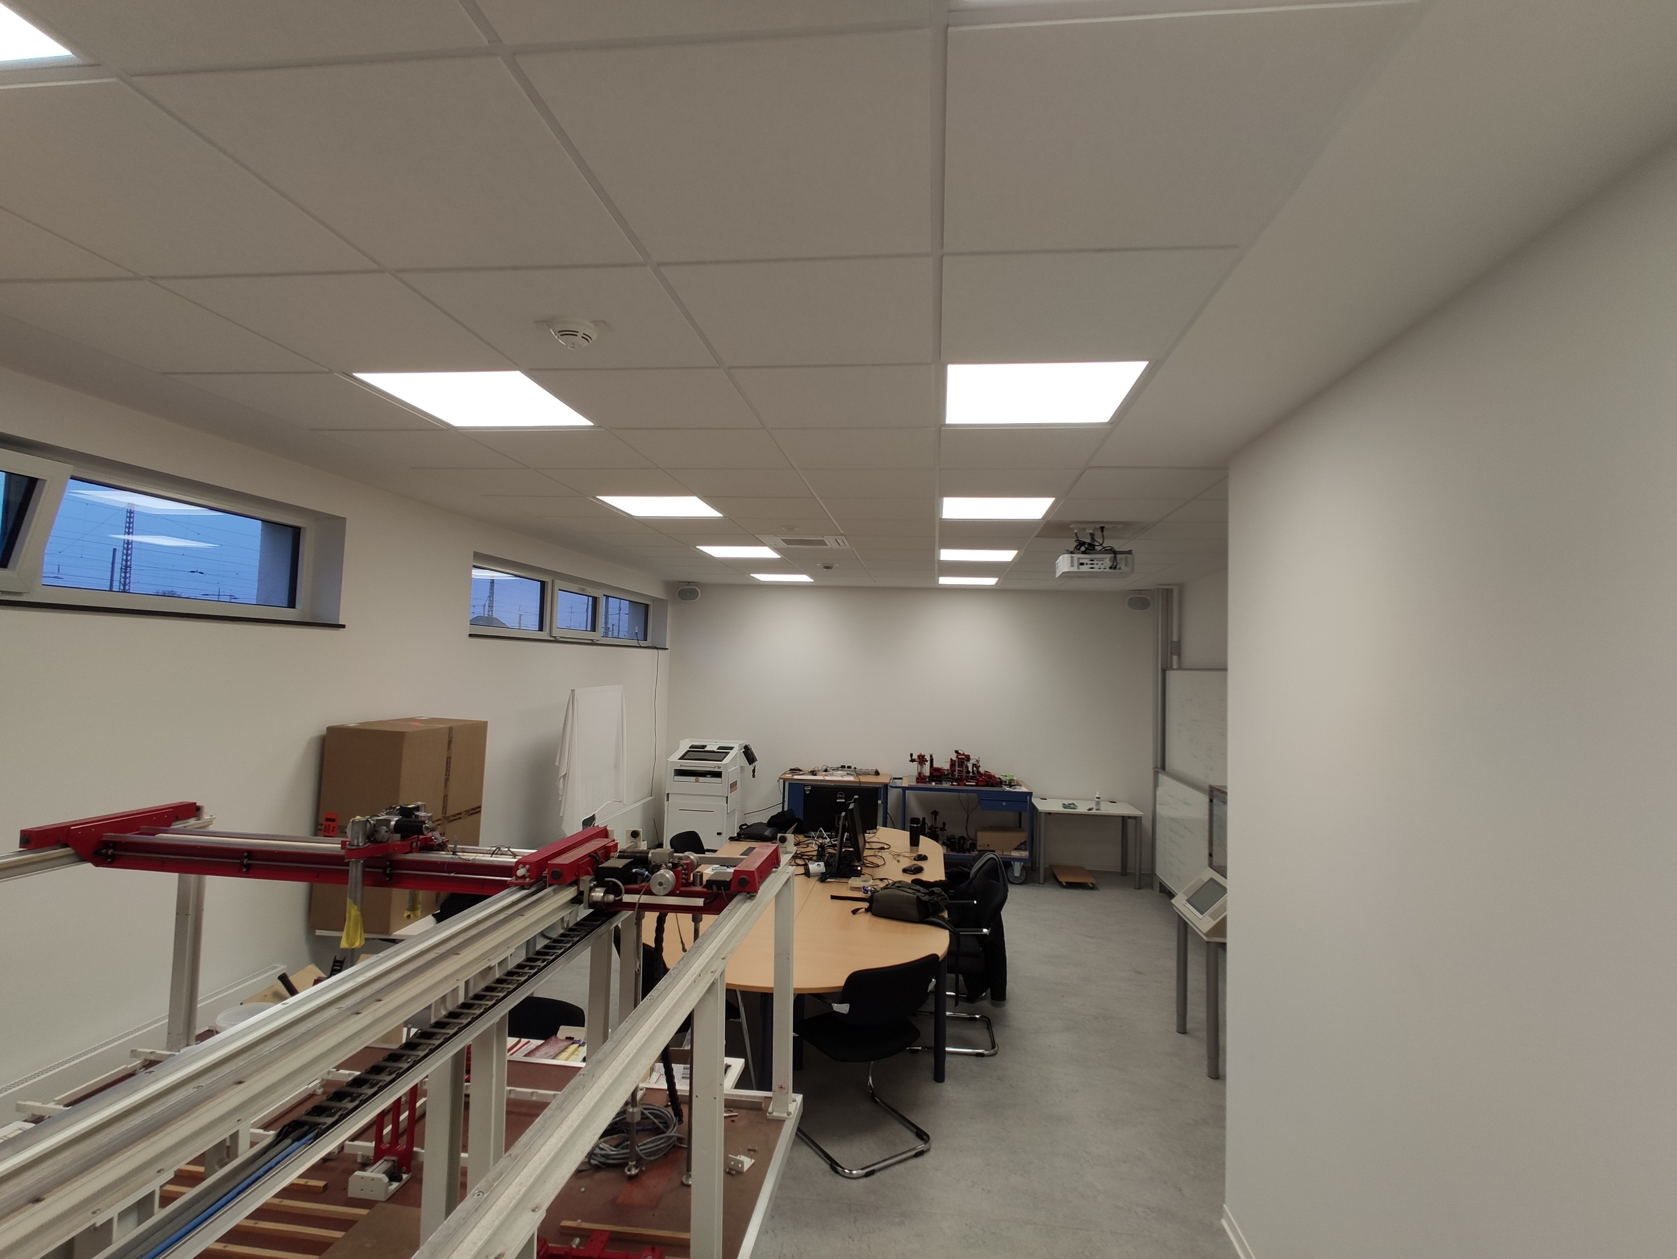

Slide 4
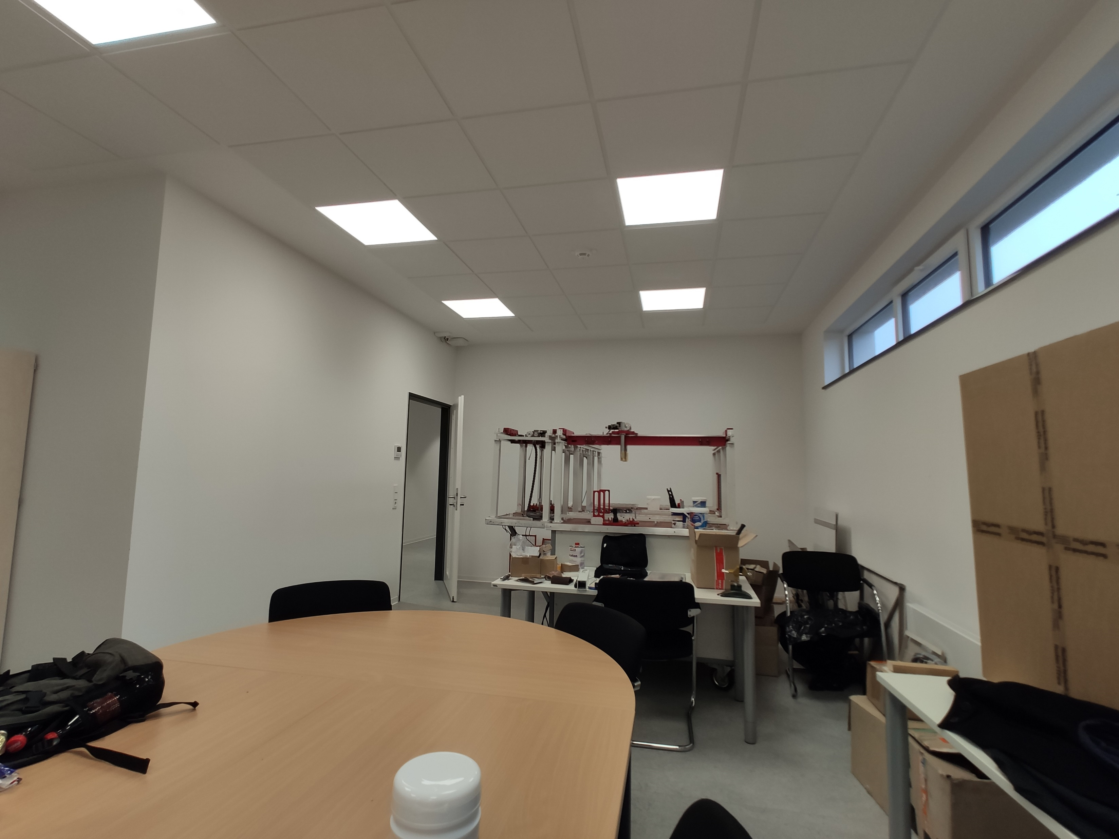

Slide 5
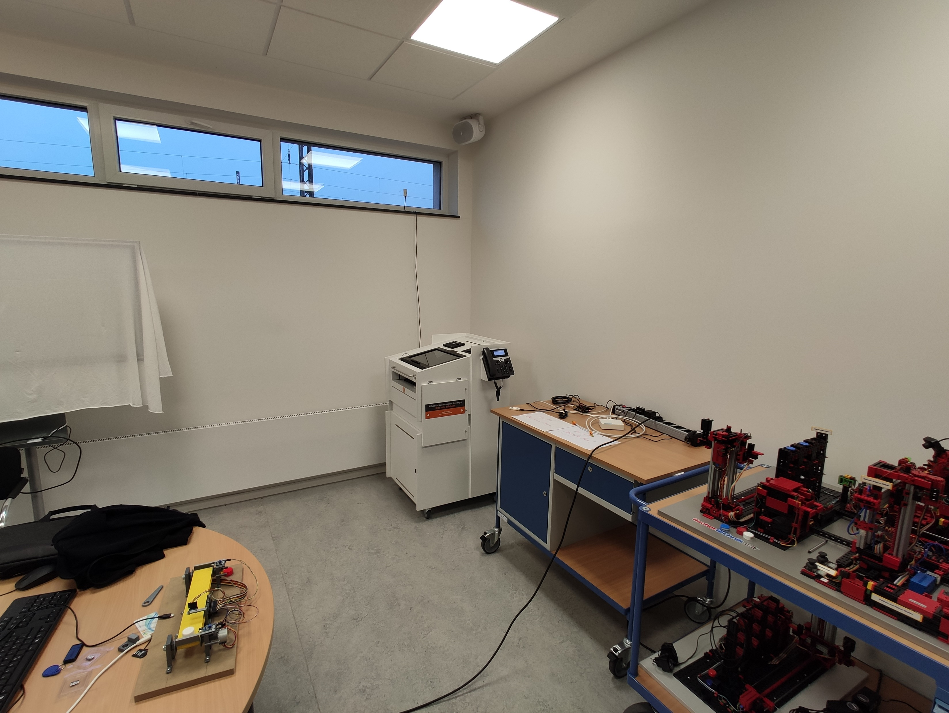
Sensor #2
Sensor #1
Sensor #3

